Slide 1
Variant Calling using binomial distribution
Computational Genomics - 13M111GI
Electrical Engineering and Computing
University of Belgrade – School of Electrical Engineering
Aleksandra Panajotu : 2020/3359

Slide 2
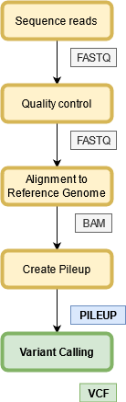
Variant Calling
Process of finding differences between reference genome and observed sample
Many variant calling tools available:
Samtools/mpileup, FreeBayes, GATK, Platypus, etc.
Each has slightly different results
Samtools-mpileup with Bcftools-call was used as a reference for this project
Input to variant calling tool is a pileup file
text-based file that summarizes base calls of aligned reads to a reference sequence
Output is VCF (Variant call file)
Text-based file that stores gene sequence variations

Slide 3
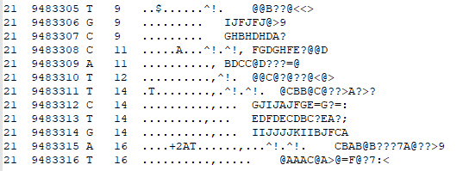
Variant Call Input file - Pileup
Pileup format consists of five mandatory and one optional column:
Sequence identifier
Position in sequence (1-based)
Reference nucleotide at that position
Number of aligned reads on that position (Depth of coverage)
Bases at that position from aligned reads
Phred Quality of those bases (ASCII with -33 offset) - optional

Slide 4
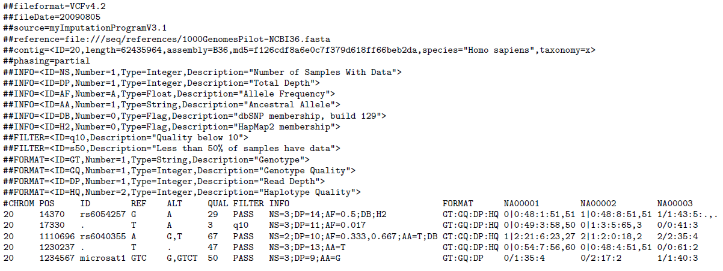
Variant Call Output file – VCF example

Slide 5
Types of variations
No variation
SNV – Single Nucleotide Variation - substitution of a single nucleotide base for another
INDEL – Insertion or deletion one or multiple nucleotide bases

Slide 6

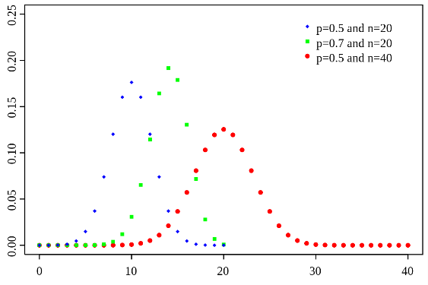
Binomial distribution
Models the number of successes in a sequence of true/false experiments
Parameters:
n - number of trials
p - probability of a success in a single trial
Probability that k out of n trials will be success
In the implemented Variant calling algorithm, for every pileup line:
Find two bases with most occurrences, b and b’ (b, b’ ∈ [A, C, T, G])
n is number of occurrences of both bases, k is number of b’ bases
Genotype is bb; k bases are errors, n-k are correct
Genotype is b’b’; n-k bases are errors, k are correct
Genotype is bb’; all n bases are correct
Algorithm should find the most probable case and use it to generate a line in VCF file

Slide 7
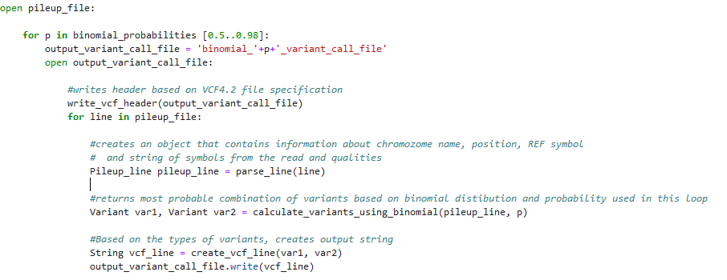
Implemented algorithm
Implemented in Python 3, using pandas and numpy libraries

Slide 8
Metrics
For generation of pileup file and reference .vcf were used Samtools-mpileup and Bcftools-call from CancerGenomicsCloud app library
Generated .vcf files were compared to reference .vcf
TP (True positives): Same variant call found in both .vcf files
FP (False positives): Variant call found in generated .vcf, but not in the reference
FN (False negatives): Variant call not found in reference .vcf, but found in the generated
Precision: Number of positive predictions that actually belong to the positive class
Recall: Number of positive class predictions made out of all positive examples in the dataset
F-Measure: single score that balances both the concerns of precision and recall in one number

Slide 9
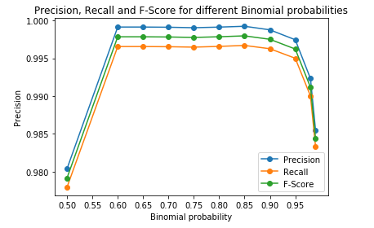
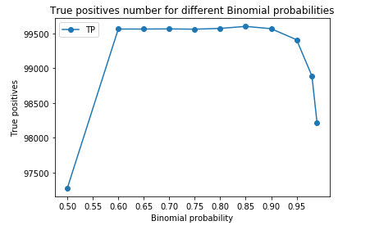
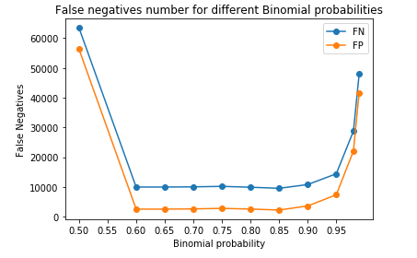
Results
Precision, recall and F-score improve with probability of success being higher than 0.6 and deteriorate when probability is higher than 0.85.
Best results are seen when probability is 0.85:

Slide 10
Future work and improvements
Adding possibility of processing and calling microsatellites and Large Indels
Analysis of Qualities for more accurate predictions of sampling errors
Adding possibility of comparing multiple samples

